Slide 1






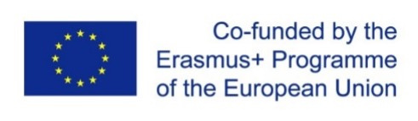
Project No. 2025-1-IT01-KA220-VET-000358118
DEVELOPED BY:
REsilience to climate change through NAture-based
Technologies in UE: an open Resource Education programme
ReNature Comparative Report
A novel biogeographical comparative analysis for assessing the state of the art of Nature-based Solutions implementation in the European Union across the environmental, economic, and social dimensions of sustainable development
Authors:
Piero Ciccioli (piero.ciccioli@cnr.it)
Maura Marchegiani (maura.marchegiani@unistrapg.it)
Lucilla Jommi (l.jommi@phd.unistrapg.it)
Matilde Luzzetti (m.luzzetti@studenti.unistrapg.it)

Slide 2




The Micro–Meso–Macro Analytical Architecture
Three connected levels transform local evidence into European comparative knowledge.
Micro — Case Studies
Meso — National Reports
Macro — Comparative Report
Two organisations per partner country capturing local implementation, success factors, and co-management dynamics.
Synthesise NbS state-of-the-art across environmental, economic, and social dimensions, linking local evidence to national policy.
Reinterprets national findings through biogeographical and cross-dimensional lenses to reveal patterns invisible at lower scales.
Notes:
2

Slide 3
National Matrices and Comparative Lenses
Common Analytical Matrix
Four Purposes
Each national report identifies:
Comparability
Multidimensionality
  Environmental: 1 critical issue + 1 strength
  Economic: 1 critical issue + 1 strength
  Social: 3 critical issues + 3 strengths
Shared analytical categories across all partners
Reflects NbS's simultaneous environmental, economic, and social effects
Greater social attention reflects its complexity: participation, access, co-management, acceptance, and territorial inclusion.
Balance
Transferability
Captures both barriers and enabling conditions
Biogeographical framing distinguishes context-specific from cross-regional patterns
Notes:
3

Slide 4

Analytical Pipeline:
Occurrence and Co-occurrence Analysis
Co-occurrence Analysis
Cross-analyse units across three dimensions; build intersection matrix
Occurrence Analysis
Assign units to four regions; record frequency
Occurrence analysis shows what recurs across regions and dimensions. Co-occurrence analysis shows how recurrent elements combine — together enabling a structured European interpretation of national findings.
Notes:
4

Slide 5
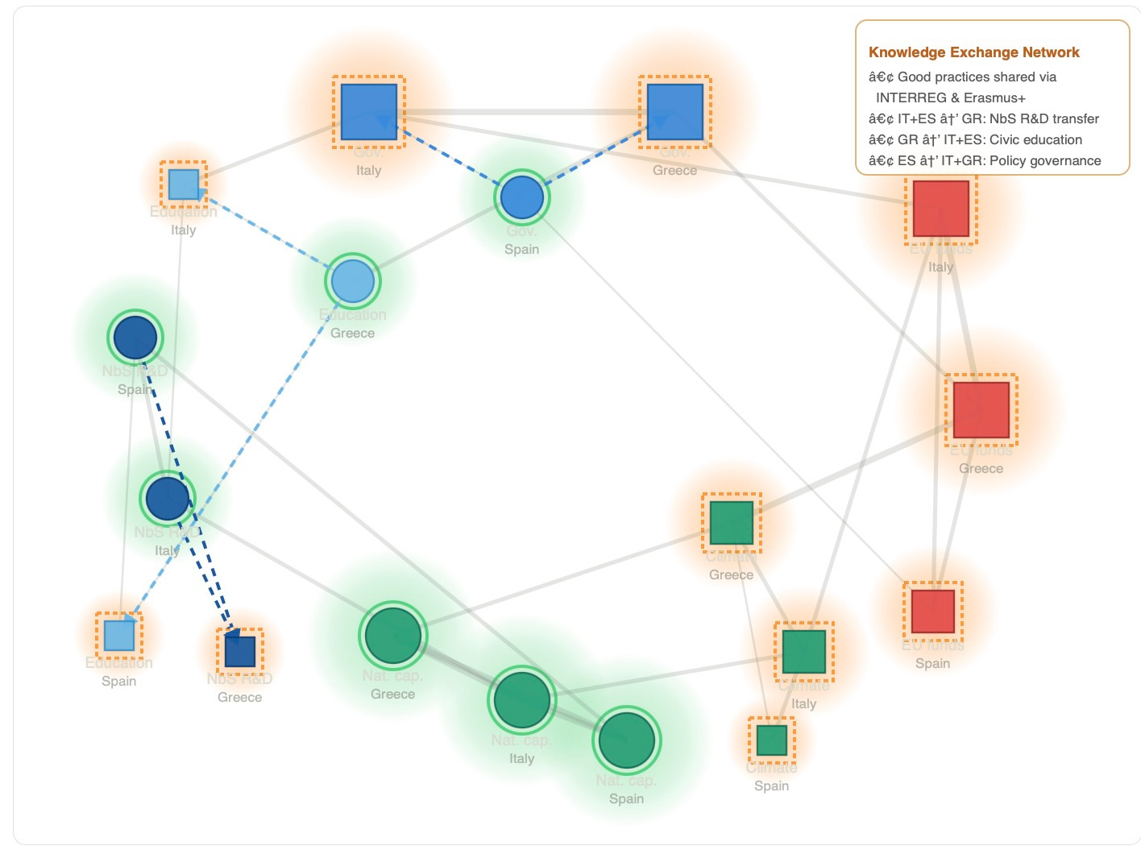
From Matrices to Node Networks
What the Networks Show
  Most recurrent issues and most connected strengths
  Regional patterns — dense or fragmented
  Emerging convergences, tensions, and trade-offs
Methodological note: Networks do not show causal relationships or statistical correlations.
Notes:
5

Slide 6
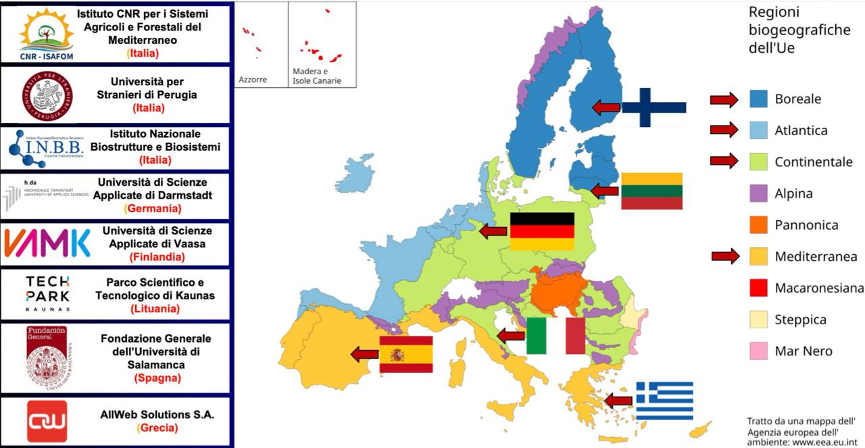
The EEA Framework and RENATURE's Four Macro-Clusters
🌊 Mediterranean
Italy, Spain, Greece
🌲 Continental
Germany, Italy
🌊 Atlantic
Spain, Germany
🌿 Boreal
Finland, Lithuania
RENATURE uses the European Environment Agency's biogeographical classification — grounding analysis in biophysical realities, not political boundaries.
Notes:
6

Slide 7



Cross-Regional Reading through
three Sustainability Dimensions
Environmental Dimension
Economic Dimension
Social Dimension
Ecosystem degradation, biodiversity loss, habitat exposure. Mediterranean burnt area may increase up to 187% under a 3°C warming scenario.
Agriculture, infrastructure, and investment gaps. Over half of global GDP depends on nature; NbS investment must triple by 2030.
Differential vulnerability, unequal access to green infrastructure, territorial marginalisation, participation, and co-management.
Notes:
7

Slide 8
Partner Countries as a Coherent European NbS Consortium
The partnership is representative by design — combining territorial breadth, ecological diversity, and institutional variety.
Italy
Coordinator; Mediterranean–Continental interface; agro-forestry, soil protection, flood prevention
Spain
Mediterranean–Atlantic bridge; urban greening, sustainability-oriented planning
Greece
Eastern Mediterranean; water stress, wildfire risk, coastal vulnerability
Germany
Continental–Atlantic; advanced environmental planning, fragmented urban landscapes
Finland
Core Boreal; forests, peatlands, carbon storage, rapid climate shifts
Lithuania
Boreal and Baltic–Eastern European; expands the European NbS evidence base
Notes:
8

Slide 9
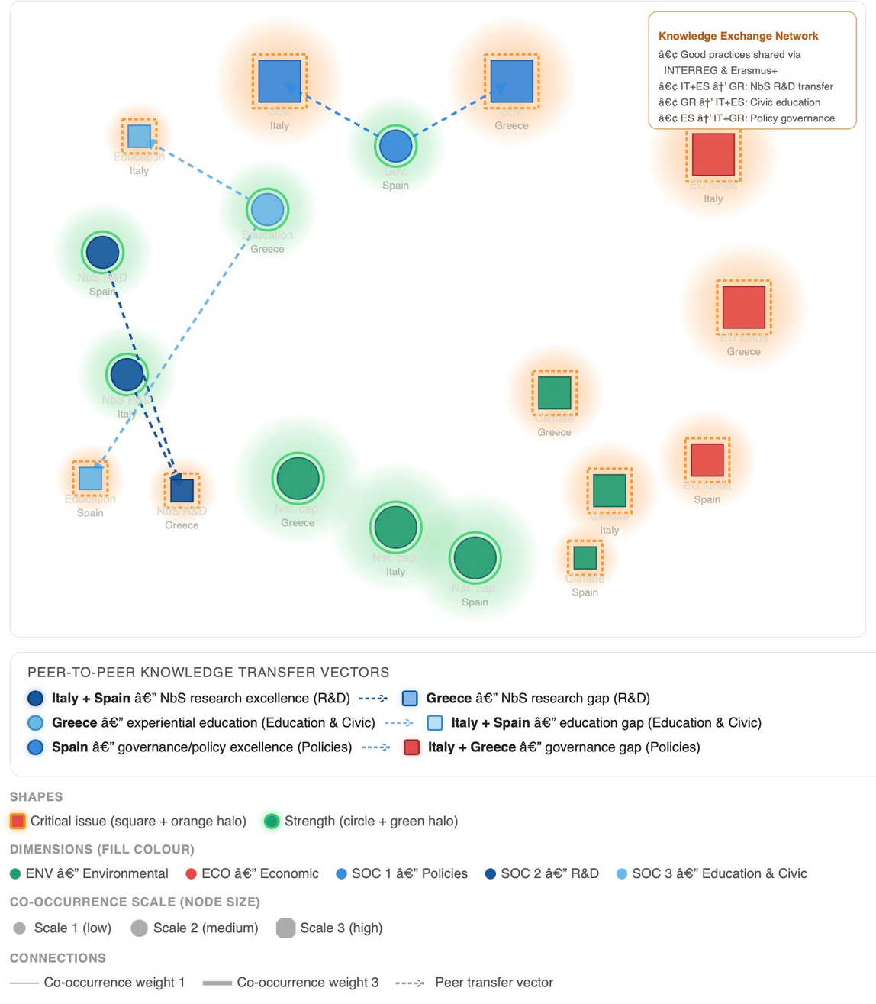
The Mediterranean Region: Shared Patterns and Key Challenges
Notes:
5

Slide 10
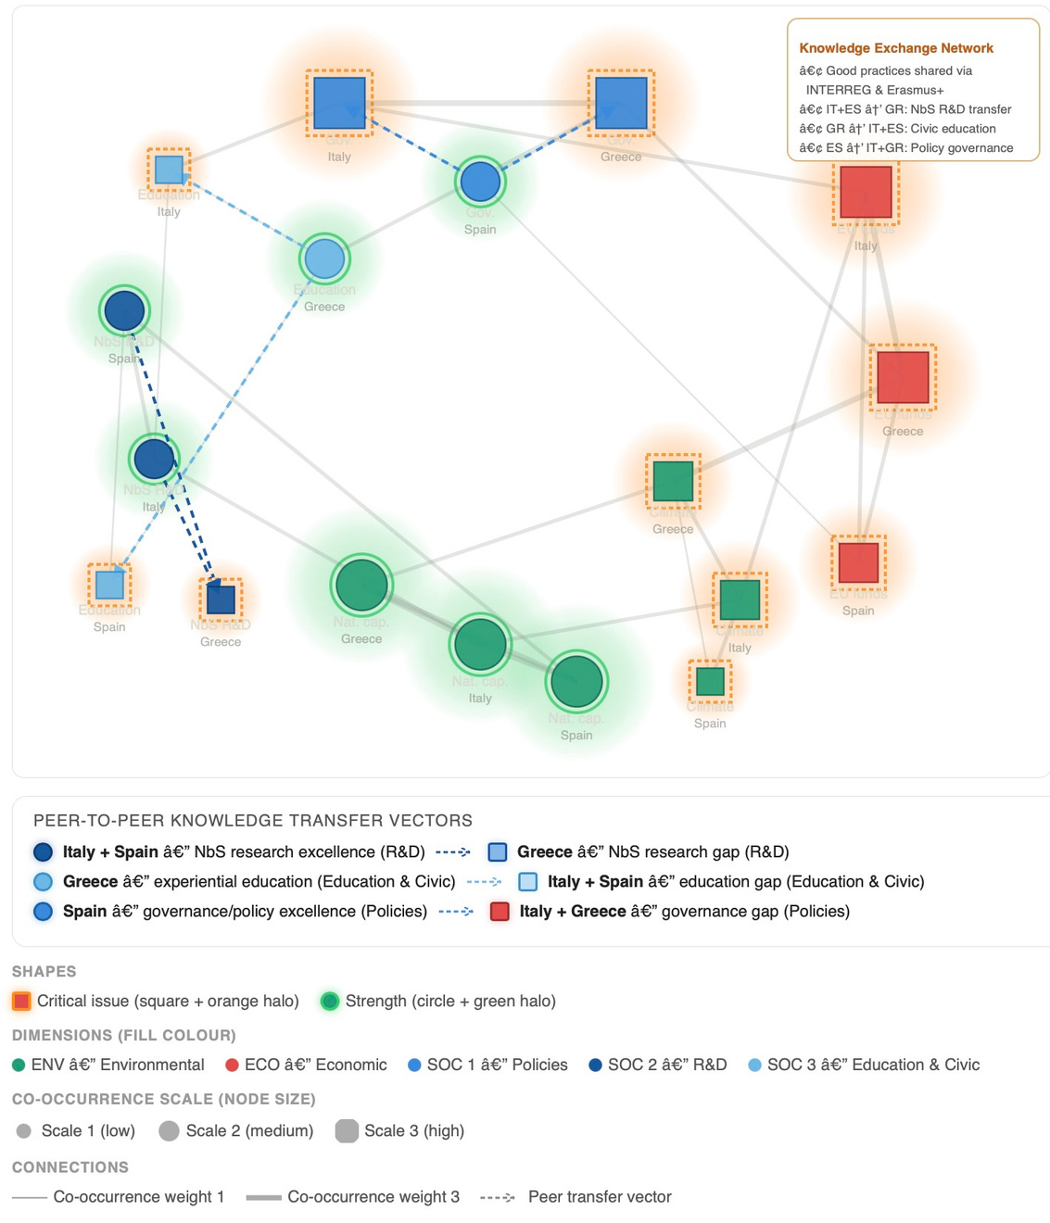
The Mediterranean Region: Shared Patterns and Key Challenges
Notes:
5

Slide 11
Project No. 2025-1-IT01-KA220-VET-000358118
DEVELOPED BY:
THANK YOU FOR YOUR ATTENTION
Authors:
Piero Ciccioli (piero.ciccioli@cnr.it)
Maura Marchegiani (maura.marchegiani@unistrapg.it)
Lucilla Jommi (l.jommi@phd.unistrapg.it)
Matilde Luzzetti (m.luzzetti@studenti.unistrapg.it)

